Slide 1
COMM 2293:
Business Communications
Section F
Prof. Emily Ballantyne
28 February 2019 – Reports: Problem and Purpose

Slide 2
Agenda
Librarian Visit
  Cindy Harrigan, Information Literacy
Informational Reports
Assignment 4
Audience Analysis
Problem & Purpose
Homework Preparation: Find a Source
Introducing a Report

Slide 3
Cindy Harrigan
SMU Librarian
Guest Speaker

Slide 4
Audience Analysis and Report Organization
Direct Approach
If readers
are informed
If readers
are supportive
If readers are
eager to have
results first
Direct
Organization

Slide 5
Assignment 4 Background
Mr. Patel recently attended the annual conference of the Canadian Federation of Independent Grocers (CFIG) in North York, Ontario. At the conference, the CFIG awarded their annual Innovators Award to several family-owned grocery stores across the country. Mr. Patel would like to apply for the award next year, but realizes Harvest Grocery needs to modernize to become innovative. He has asked you to research and write an analytical report about three or four of the latest consumer and grocery trends and recommend the best one to introduce to Harvest Grocery.

Slide 6

What is the problem?

Slide 7
Audience Analysis
What type of report does he need?
What format should it take?
Which approach should we use?
What does he need to know?
What kind of research does he expect you to do?
What kind of research would he trust?
Why is this research significant for him and his employer?

Slide 8
Assignment 4 Summary
Structure
Content
Length: Two-pages
Strategy: Direct Strategy
Report type: Informational report
Format: Memo
Sources: 3 minimum
Citation Format: APA Style
What are the latest grocery trends?
Which trend should Harvest Grocery adopt?
Why should they adopt this trend?

Slide 9
Statement of Purpose for Research
Identify the purpose. Describe what the report needs to do or accomplishing using a focused action verb.
Define the problem(s) to be solved. Include any variables, objectives or specific details that need to be included.
Determine any constraints or limitations. Identify the limitations of your research methods (e.x. time, money, research parametres)
State the significance. Explain why this report matters and will have an impact on its intended audience.

Slide 10
Example Statement of Purpose
The purpose of this report is to recommend a plan that provides sales reps with cars to be used in their calls. The report will compare costs for three plans: outright ownership, leasing, and compensation for employee-owned cars. It will also measure employee reactions to each plan. The report is significant because Pharmgen’s current leasing agreement expires March 31 and an improved plan could reduce costs and paperwork. The study is limited to costs for sales reps in the Edmonton district.
(p. 320)

Slide 11
Email me an expanded purpose statement for Assignment 4.
Include:
-Purpose
-Scope
-Limitations
-Significance

Slide 12
Memo Format for Assignment 4
TO: reader’s name, position
FROM: your name, position
DATE: due date
SUBJECT: specific to purpose of report
Introduction (direct reply opening)
Body (three or more sections with headings)
Conclusions (including direct reply closing)
Review page 2 header on Figure 12.11 (p. 374)

Slide 13
Homework Preparation for Tuesday
Find three online source for your report. The sources should be something that you think Arjun Patel would find credible.
Print the source. Make sure you have noted all of the publishing information about where it came from (e.x. URL, author, date)
Write a sentence using a signal phrase that incorporates each source. You can use a combination of paraphrase and direct quotation.
Bring a copy on Tuesday. This will count toward other writing grades, and will prepare you for the APA Homework assignment!

Slide 14
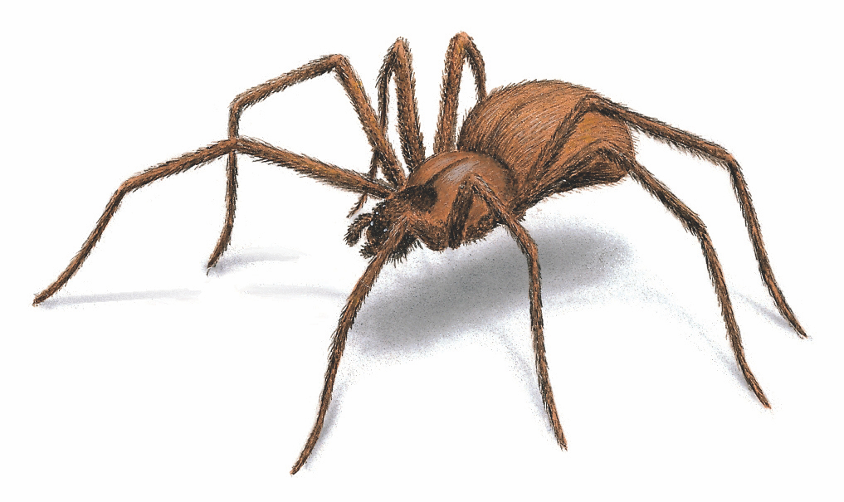

Credibility of Sources
How do I assess online research?
  Currency
  Authority
  Content
  Accuracy
The internet is a web that can catch you.

Slide 15
Assessing Credibility
Currency
  How current is the information?
  Check: Date of publication
Authority
  How credible is the author or source?
  Check: Credentials of the author/corporation, use of references, sponsors/promoters
Content
  What is the purpose of the site?
  Check: the classification of page, audience, tone, style
Accuracy
  Do the facts seem reliable?
  Check: references, bias, spelling/grammar

Slide 16
What is wrong with these sources?
Emily’s Homework Assignment
Source 1:
[deleted] (2018) suggests that women experiencing high stress buy yogurt and men with bushy beards buy beer.
r/AskReddit, “Grocery store cashiers, do you notice any trends on what people look and act like based on the food they buy?”
https://www.reddit.com/r/AskReddit/comments/7wppet/grocery_store_cashiers_do_you_notice_any_trends/
Source 2:
According to Marketing Magazine (1996), “one in five grocery shoppers in Canada buys take-out in the supermarket.”
Marketing Magazine, Toronto, vol 101, issue 23, June 10 1996, pg 4.

Slide 17
Don’t forget to bring in your 3 sources for our class on Tuesday!

Slide 18
For Tuesday
Reports: Research & Credibility
Read: Chapter 11: 272-281
Chapter 12: 314-334
Coursepack: 11-12
Chapter 5: 117
Review: Online sources relevant to Assignment 4
Write: Bibliographic information for the source onto the printed copy of the source.

